Slide 1

State Response Operations Plan (SROP)
Webinar
April 22, 2015
“A Prepared Marylander Creates a Resilient Maryland”

Slide 2
Presenters
Nicole Lanigan, Senior National Capital Region Planner
Kyle Overly, Preparedness Planner
Elizabeth Webster, Adaptive Planning Branch Manager

Slide 3
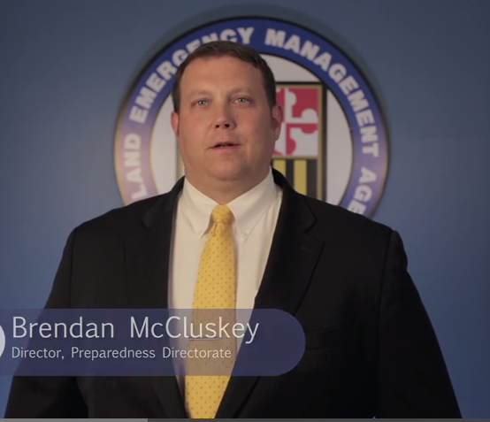
Welcome
Brendan McCluskey, Director of Preparedness

Slide 4
Operations Overview
Kate Hession, Director of Operations

Slide 5
Webinar Objectives
Understand the way MEMA prepares and plans for disasters under the Maryland Emergency Preparedness Program (MEPP)
Review the State Response Operations Plan (SROP) to understand how agencies coordinate and share information and resources
Discuss the roles and responsibilities of the Emergency Support Functions (ESFs)
Introduce the new Advance Team Protocol

Slide 6
Agenda
MEPP Overview
SROP
SEOC Activation
ESFs

Slide 7
Webinar
SROP
SEOC
Activation
ESFs
MEPP Overview

Slide 8
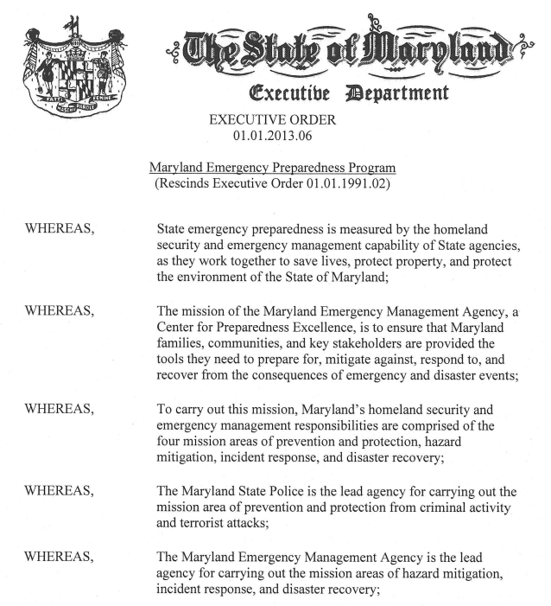
Maryland Emergency Preparedness Program (MEPP) Executive Order
Gives MEMA the primary responsibility and authority for emergency preparedness policy, and the mission areas

Slide 9
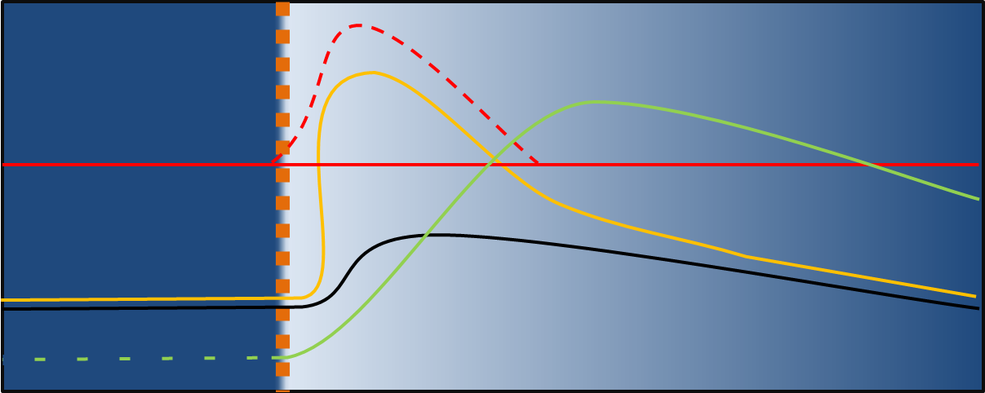
Defining “Preparedness”
Readiness and preparation to operate
Always ongoing and present in all phases of an emergency
Event
Intensity of Operations
 | Prevention/Protection
 | Response
 | Mitigation
 | Recovery
 | Preparedness
Time
Notes:
The mission areas characterize the operations occurring during each phase of an emergency.

Slide 10
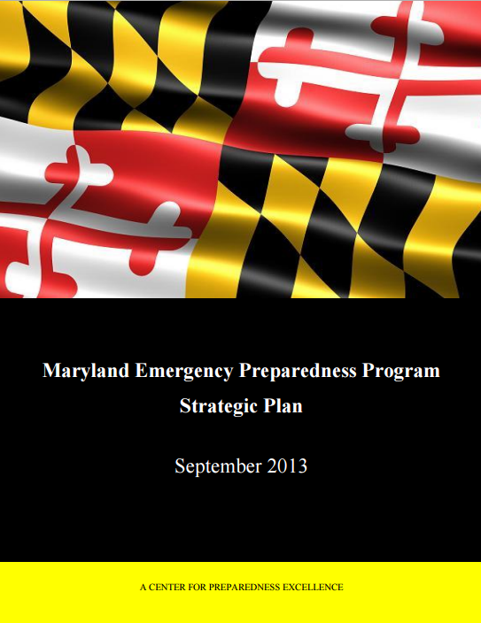
What is the MEPP?
The State’s overarching construct for emergency preparedness and operations
An innovative, all-hazards approach to comprehensive, statewide preparedness
MEPP Strategic Plan institutionalizes the coordination of emergency preparedness activities

Slide 11
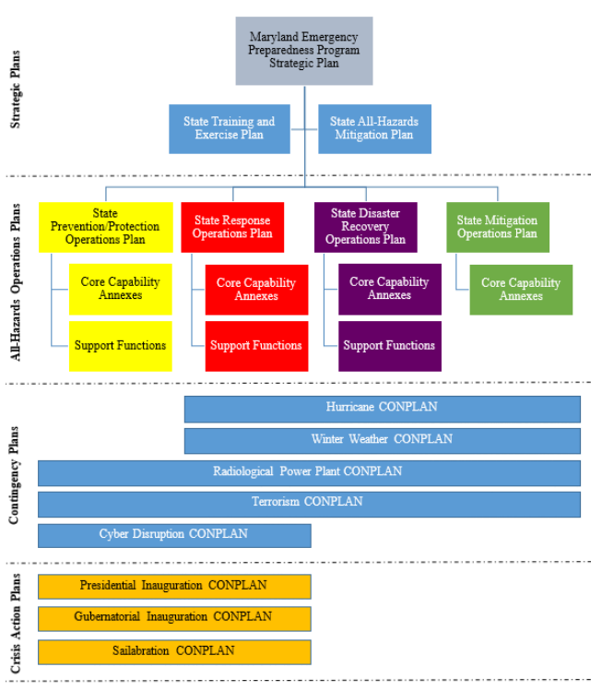
MEPP Hierarchy
Notes:
The MEPP Planning Hierarchy Chart was developed to provide an at-a-glance perspective of the entire set of Maryland planning
documents, and is organized according to the function served by each plan.
Strategic Plans identify risk reduction and preparedness policy goals and objectives to enhance planning activities, direct organizational changes, prioritize the allocation of resources (including the expenditure of general and grant funds), and/or establish a training and exercise program.
All-Hazards Operations Plans (OPSPLANs) are deliberate plans that identify and explain the mission area’s standard all-hazards concept of coordination and concept of operations for executing the mission area’s specific capabilities, under most circumstances. These plans include functional groupings of relevant stakeholders around common organizational authorities and resources. The four OPSPLANs are the SPPOP, SROP, SDROP, and SMOP.
Contingency Plans are deliberate scenario-specific interagency/intergovernmental concept plans (CONPLANs) that support the general mission-area concept of coordination and concept of operations of one or more OPSPLANs. Contingency plans are developed in anticipation of a future specific threat, hazard, incident, or disaster that requires additional coordination beyond the guidance provided in the OPSPLANs.
Crisis Action Plans are scenario-specific operational plans that are developed over a shorter time frame in reaction to an actual threat, hazard, incident, or disaster. Crisis action plans are adaptive, meaning they are flexible to address changing emergency conditions. Crisis action plans also have a defined time period that expires at the conclusion of the scope of the plan.

Slide 12
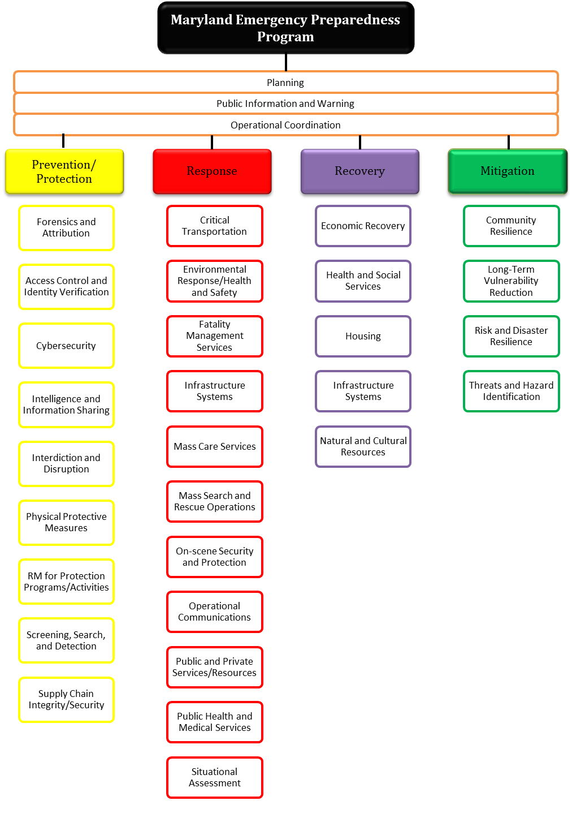
Capabilities Organized by Mission Area
Means to accomplish a mission, function, objective
Execution of related tasks to reach a specific level of performance
Notes:
Capabilities
Means to accomplish a mission, function, objective
Execution of related tasks to reach a specific level of performance

Slide 13
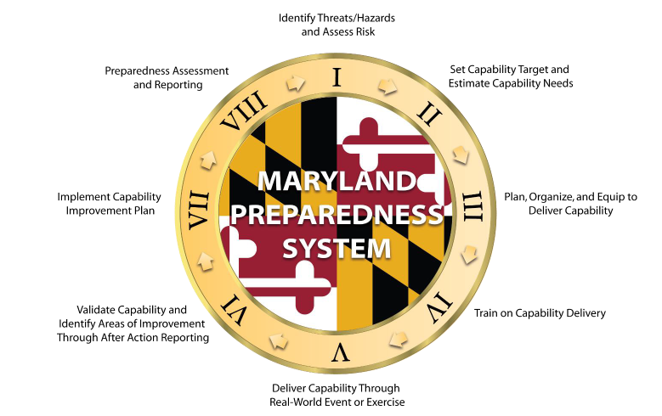
Maryland Preparedness System
Each mission area is broken into capabilities
This process builds and sustains capabilities to continuously improve the State’s ability to manage risk
Notes:
Each of the mission areas is broken into capabilities. As part of the MEPP, Maryland applies an eight step process, referred to as the Maryland Preparedness System, to continuously improve the State’s ability to manage risk by building and sustaining capabilities.
Build, maintain, sustain, and improve capabilities
Steps 1 and 2 are the THIRA process – segue into THIRA discussion

Slide 14
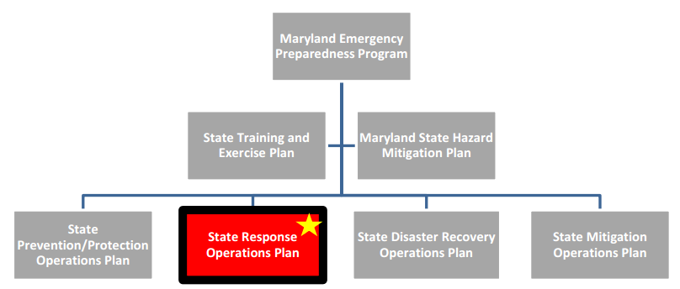
Next up: the State Response Operations Plan (SROP)

Slide 15
Webinar
MEPP Overview
SROP
SEOC
Activation
ESFs

Slide 16
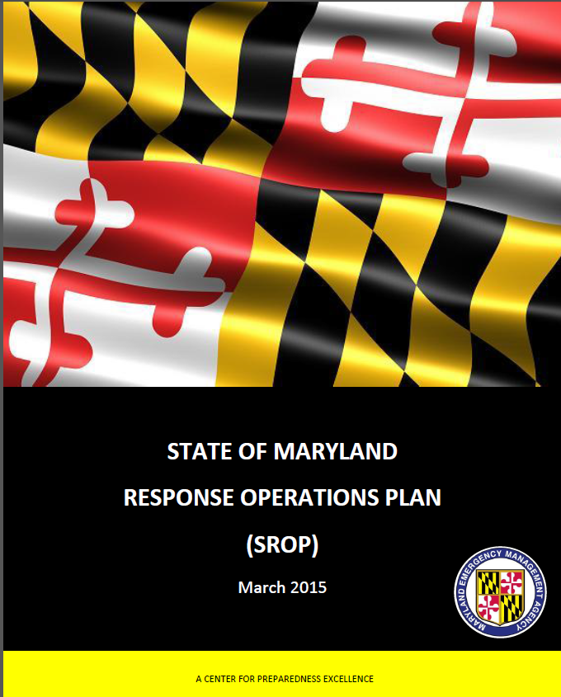
State Response Operations Plan(SROP)
Outlines processes for State-level incident responses to all hazards
Actions identified are based on existing State agency statutory authorities
Notes:
The State Response Operations Plan (SROP) was developed as the Response Mission Area Operations Plan within the Maryland Emergency Preparedness Program (MEPP) and outlines processes used for State level incident responses to all hazards. The SROP describes the roles and responsibilities of entities within Maryland during incident response operations.

Slide 17
Mission Statement
“Ensure the ability of the State of Maryland to coordinate emergency operations in response to incidents of varying size and scope by engaging all necessary state, local, federal, private sector, and voluntary, faith based, and nongovernmental agencies in order to address the needs of Maryland residents, visitors, and communities”
Notes:
Response operations focus on ensuring that the State is able to effectively respond to any threat or hazard, including those with cascading effects, in order to save and sustain lives, protect property and the environment, stabilize the incident, rapidly meet basic human needs, and restore essential community services and functionality.

Slide 18

Objectives
Maintain 24/7 situational awareness across the State of Maryland, the nation, and around the world.
Coordinate the activities of State, local, federal agencies, non-profit organizations, and private-sector partners in support of incident response.
Facilitate the transition from incident response to disaster recovery.
Notes:
The objectives outlined here are to be met during the execution of the SROP.
Maintaining awareness of an incident provides the basis for decision-making and resource management. A state that can develop situational awareness has the capability to effectively coordinate the support of its agencies/departments to resolve an incident.
The SROP applies to all State departments/agencies, private, and non-profit organizations tasked to provide resources and execute mission assignments during response operations. It describes the actions of the State to provide assistance to one or more affected counties or municipalities, and, under catastrophic circumstances, to other state governments.
This Plan identifies short-term recovery/stabilization activities, including requesting federal declarations for recovery assistance. Short-term recovery/stabilization assistance includes the coordination of all federal and State efforts to restore the public and private sectors to pre-incident function and to support the transition of impacted communities towards long-term recovery efforts, as needed.

Slide 19
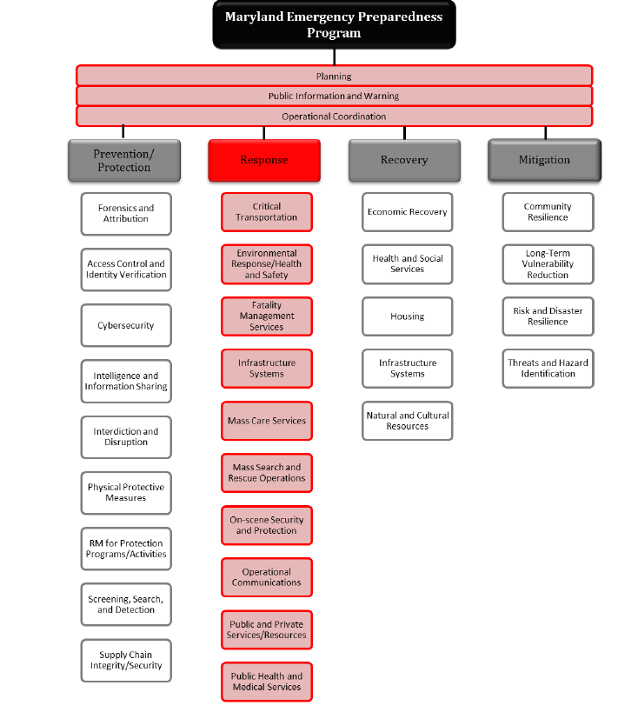
Response Capabilities
The Response Mission Area capabilities are a list of the activities that generally must be accomplished during response operations, regardless of which levels of government are involved.
Notes:
The Response Mission Area includes fourteen (14) capabilities and includes those capabilities necessary to save lives, protect property and the environment, and meet basic human needs after an incident has occurred.
It is focused on ensuring that the State is able to effectively respond to any threat or hazard, including those with cascading effects, with an emphasis on saving and sustaining lives and stabilizing the incident, as well as rapidly meeting basic human needs, restoring basic services and community functionality, establishing a safe, secure, accessible environment, and supporting the transition to recovery.
The figure illustrated here outlines the capabilities for each of the four mission areas as defined by the Mission Area Operations Plans.

Slide 20
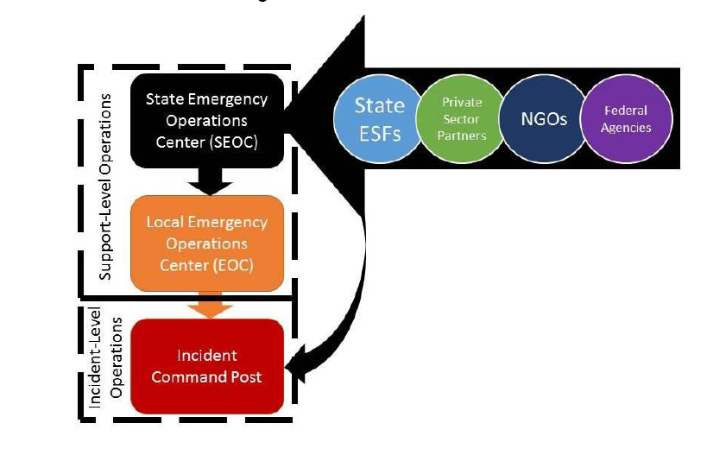
Concept of Coordination
Notes:
All incidents originate at the local level, initial response operations begin with local jurisdictions working with county emergency management agencies. Local jurisdictions have the capability to effectively engage in response operations for most emergencies/disasters without any outside assistance.
If an incident evolves into such magnitude that resources and/or coordination requirements exceed local capabilities, assistance from the State may be necessary.
It is only after local incident response resources are exhausted or resources that the jurisdiction does not possess are requested, that local authorities may request State incident response resources and assistance.
Similar to when a local jurisdiction requests State assistance when local resources are exhausted, the State may need to request assistance from neighboring states through the Emergency Management Assistance Compact or the federal government through Federal Emergency Management Agency when State resources are exhausted.

Slide 21
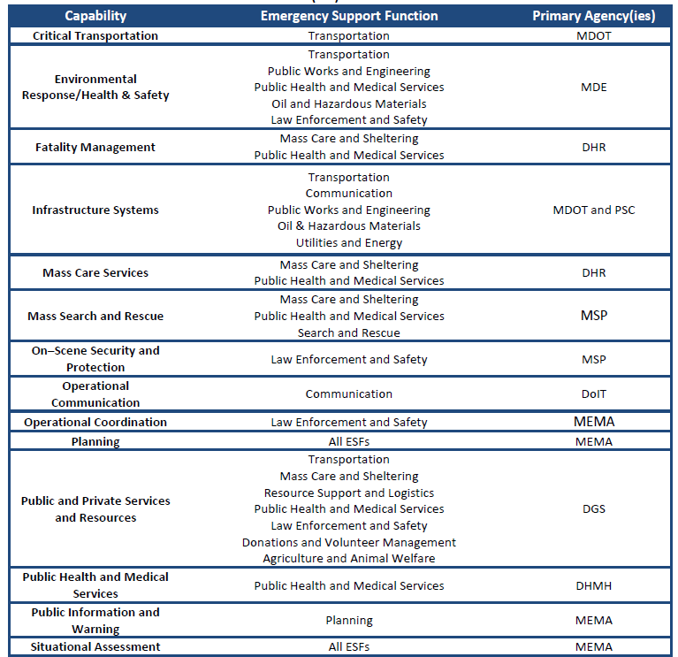
Concept of Coordination Cont.
Notes:
Response operations may require partnerships for coordination at the local, State, regional, or federal levels. The table illustrated here cross walks the Maryland Response Capabilities with State Emergency Support Function Primary Agencies.

Slide 22
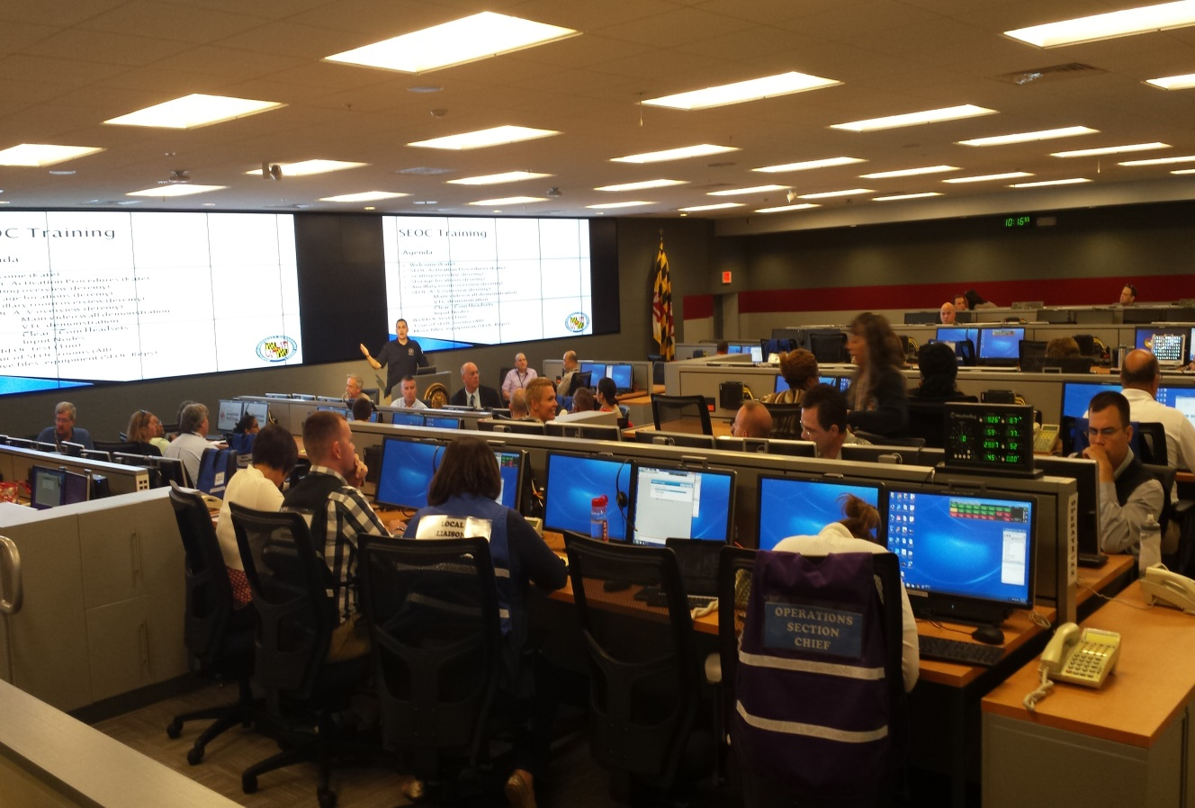
Concept of Operations
Provide and coordinate support to local jurisdictions
Receive and coordinate support from the federal government, other states, and non-profit and private sector partners
Notes:
Maryland has adopted an organizational structure to provide and coordinate support to local jurisdictions, and to receive and coordinate resource support from the federal government, other states, and non-profit and private sector partners.
This structure is similar to the Incident Command System (ICS) used to manage incidents. Unlike the ICS structure, which primarily focuses on tactics and command, the State Emergency Operations Center structure focuses on coordination of support and resources in support of the local incident operations.

Slide 23
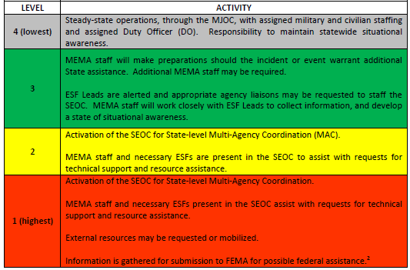
State Response Activation Level (SRAL)
Response operations are executed through four activation levels that enable a scalable and flexible posture of the two primary State-level operational components:
  Maryland Joint Operations Center
  State Emergency Operations Center
Notes:
The State of Maryland has established four State Response Activation Levels (SRAL), as noted in the table here. Each activation level represents an increased need for situational awareness and coordination of State response activities and resources.

Slide 24
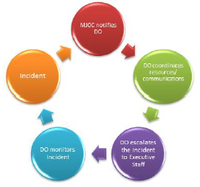
Duty Officer Program
Rotating civilian position of authority to adjudicate potential/actual emergency conditions, and assist the MJOC with the escalation of emergency notifications.
Notes:
When an incident or situation of significance occurs that exceeds the capabilities and/or authority of the MJOC, they will contact the DO.
The MEMA Duty Officer is filled by designated MEMA personnel on a rotating basis. The DO confers with the MEMA Director of Operations on the appropriate escalation of the State Response Activation Level.
The MEMA Director of Operations informs the MEMA Executive Director of any actions taken. The MEMA Executive Director convenes the Senior Policy Group (SPG) if actions warrant. The figure here illustrates the full process of the notification procedures for the Duty Officer and Executive Staff.

Slide 25
SRAL Escalation and De-Escalation Protocol
Flexibility: Each incident is evaluated for impact and potential effects, and the appropriate SRAL is assigned.
SRAL may be escalated to coordinate activities of pre-planned special events.
Eventually, a return to Status Level 4 occurs and MEMA returns to steady-state operations.
  Note: De-escalation of the SEOC does not mean an end to all activities for an incident.
Notes:
The State Response Activation Level Escalation and De-Escalation Protocols were developed to be flexible in order to accommodate the scope and severity of an incident.
In addition to all hazards incidents, the State Response Activation Level may also be escalated during special events to coordinate activities.
An example of when the State Response Activation Level may be escalated for a special event would be the 2015 Gubernatorial Inauguration or the 2014 Star Spangled Spectacular.
In time, the State Response Activation Level will return to status level 4 and MEMA will return to Steady State operations. However, de-escalation of the SEOC does not necessarily mean an end to all activities of an incident. Intermediate and long-term recovery activities may continue for months or even years following an incident.

Slide 26

Maryland Joint Operations Center (MJOC)
The MJOC operates 24 hours a day, 7 days a week – termed the “steady-state.”
Because the MJOC maintains situational awareness through 24/7 operations, the State is always at a minimum of a Level 4, and this Plan is always in effect.
Notes:
The MJOC is the State of Maryland’s primary situational awareness, alert, warning, and notification center and maintains a 24/7 operations staffed jointly by MEMA civilians and by Maryland Military Department (MMD) personnel.
During normal, day-to-day operations, the MJOC is the primary conduit for information gathering and situational awareness for the State of Maryland. During periods of heightened response operations activity where the SEOC is being staffed, the MJOC supplements situational awareness activities within the SEOC.

Slide 27
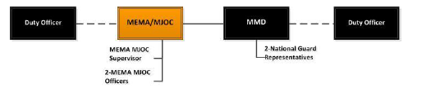
MJOC Organization
Notes:
The figure illustrated here outlines the organization of the MJOC. As previously mentioned the MJOC operates 24 hours a day/7 days a week with operations staffed jointly by MEMA civilians and by Maryland Military Department (MMD) personnel.
The MJOC also has a MEMA MJOC Manager who handles daily administration and management of the MJOC. The MEMA Duty Officer is filled by designated MEMA personnel on a rotating basis.

Slide 28
Webinar
MEPP Overview
SROP
SEOC
Activation
ESFs

Slide 29

Advance Team – Purpose
Prepare State response personnel for an increase in the SRAL
Reduce confusion/uncertainty for first OPS period
Distribute the workload
Produce a State Support Plan or MEMA-201
Create a uniform process for all activations

Slide 30
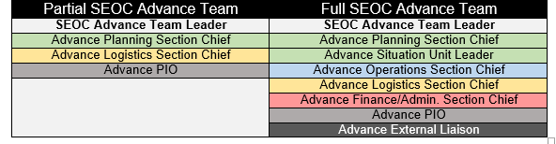
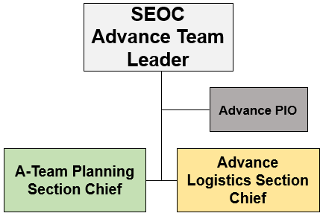
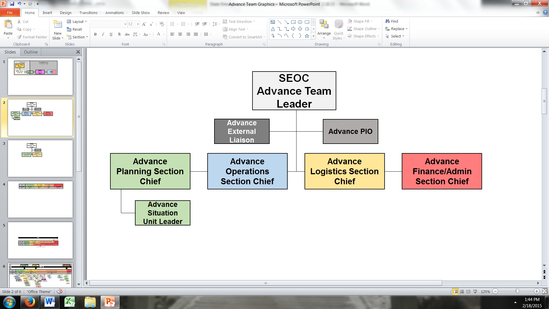
Advance Team - Makeup

Slide 31
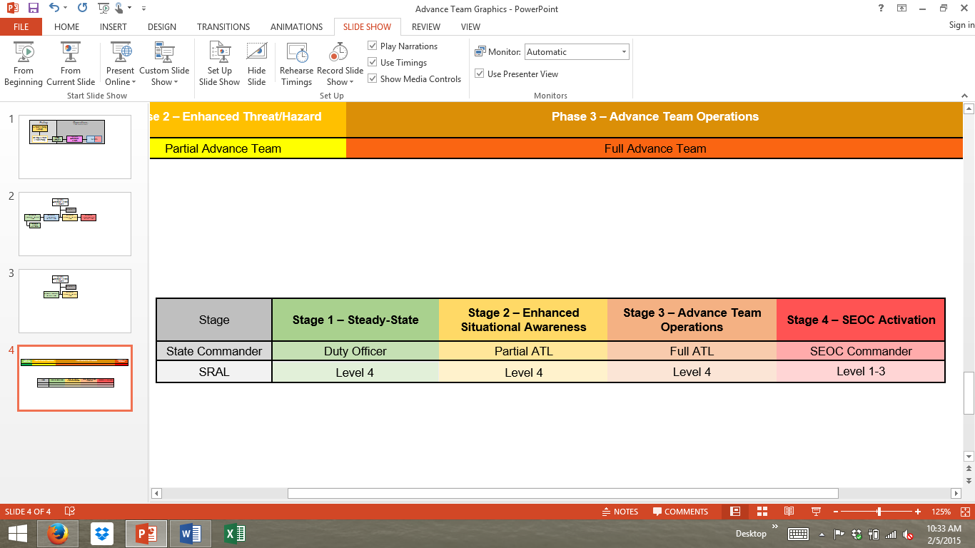
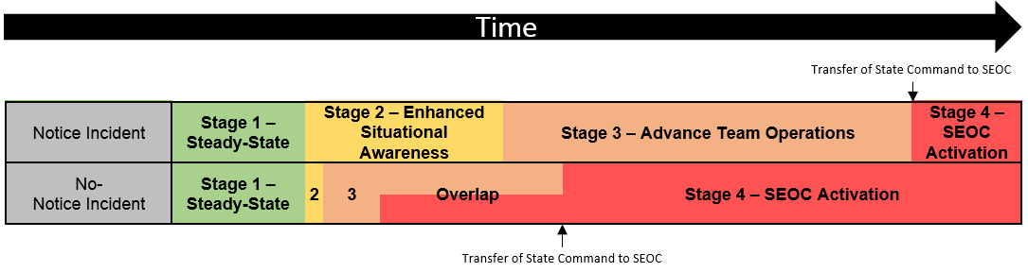
Advance Team - CONOPS

Slide 32
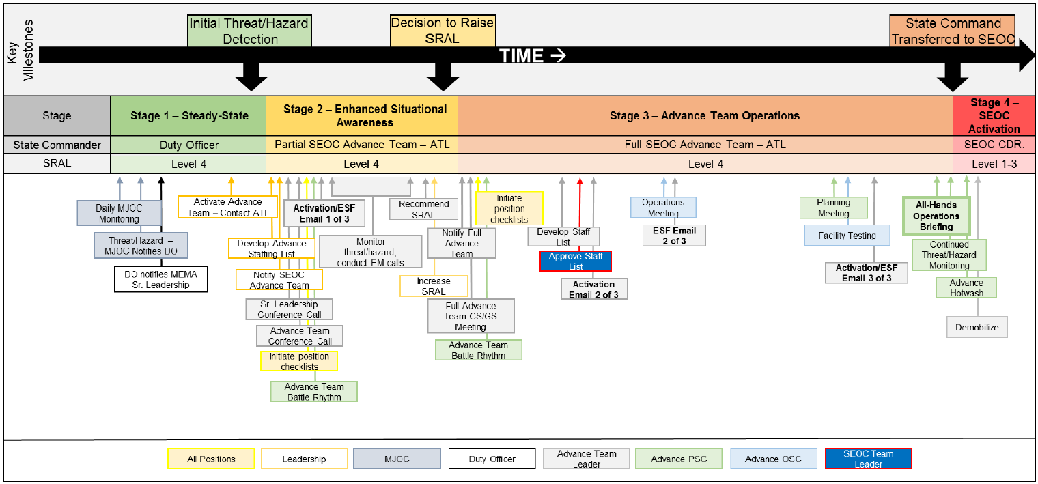
Advance Team – CONOPS

Slide 33
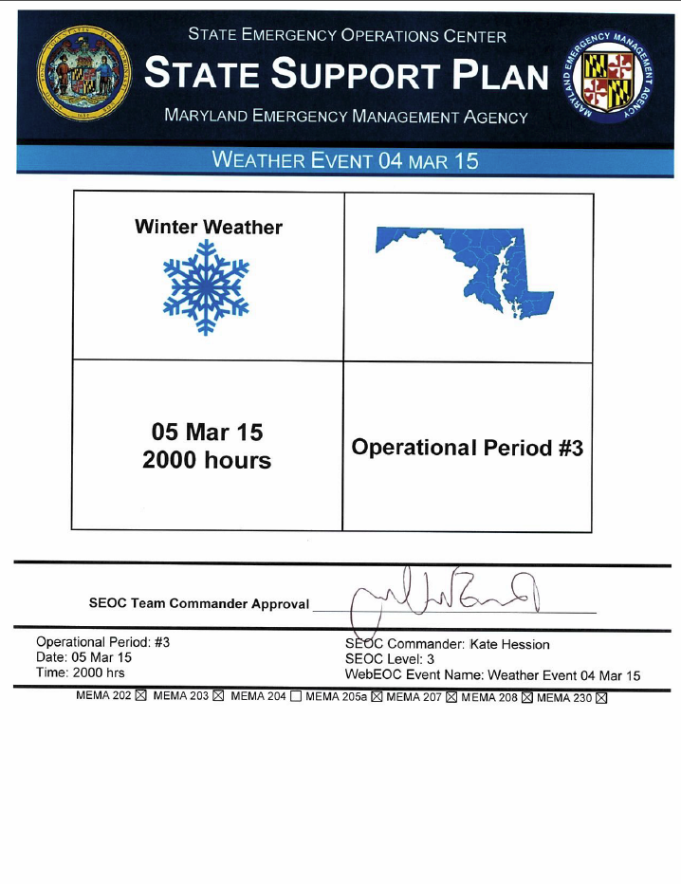
Advance Team - Outputs
Staffing/ESF roster
OPS Periods
Regional staff assignments
SSP or MEMA 201
Information collection plan and baseline data
SEOC Logistical issues
Cost-tracking
Transfer briefing

Slide 34
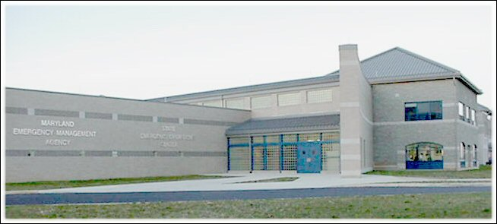
State Emergency Operations Center (SEOC)
The SEOC, located at MEMA headquarters, is the primary physical location of operations during an incident with a State Response Activation Level of 2 or 1.
Notes:
The SEOC is the primary physical location where information sharing and resource coordination take place at the State level. The SEOC is designed to accommodate a large number of emergency management partners during an incident.

Slide 35
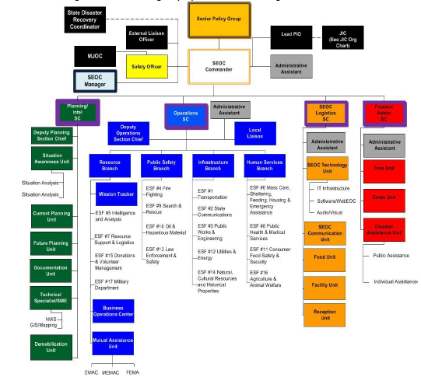
SEOC Organization and Staffing
Notes:
The SEOC is organized into five major sections of operation, in accordance with ICS: Command, Finance/Admin, SEOC Logistics, Planning/Intel, and Operations. Each of these sections is divided into functional branches, groups, or units, as needed.
MEMA’s Executive Director has overall responsibility for the State’s response operations and will establish, as needed, a Lead Public Information Officer (PIO), a Joint Information Center, and a SEOC Commander as part of his or her Command Staff.
The SEOC Commander will assign section chiefs for Finance/Admin, SEOC Logistics, Operations, and Planning/Intel from MEMA staff as needed.
The State Emergency Support Function partners fall under the various branches of the Operations Section, more information will be provided on our ESFs later on in the webinar.

Slide 36
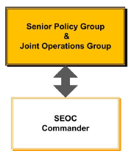
Senior Policy Group (SPG) and Joint Operations Group (JOG)
Notes:
The Senior Policy Group serves as a policy- and strategic-level deliberative body during ongoing or long-term emergency situations to analyze critical information, and support the Governor by identifying emergent needs and providing policy recommendations for action, including public messaging.
The SPG works together to ensure consistent information is being shared across the various State agencies/departments and is comprised of the MEMA Executive Director, select Governor’s Executive Staff, and senior State government officials.
The Joint Operations Group (JOG) advises the SPG on policy- and strategic-level incident-specific issues, concerns, decisions, needs, gaps, and resources. The JOG will gather initial situational information, provide high-level analysis, and coordinate actions to prevent, protect, respond to, and recover from human-caused and naturally-occurring hazards and threats.

Slide 37
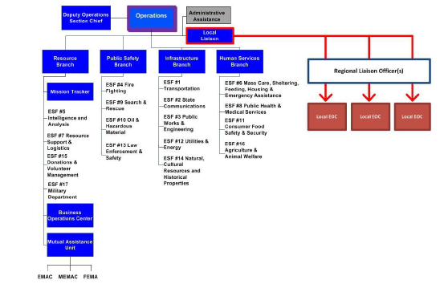
State and Local Coordination
RLOs function as members of the local jurisdictions’ Command Staff as Liaison Officers, and are responsible for ensuring local jurisdictions receive the support they request.
Notes:
The Regional Liaison Officers are critical links between Local EOCs and the SEOC. They manage requests for resources and help maintain situational awareness of local response activities. The RLOs function as members of the local jurisdictions’ Command Staff as Liaison Officers, and are responsible for ensuring local jurisdictions receive the support they request.

Slide 38
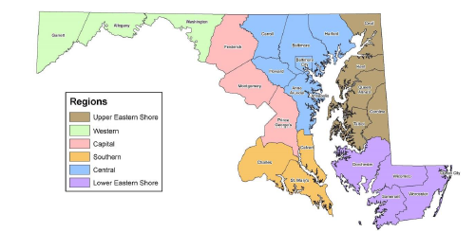
State and Local Coordination Cont.
Notes:
MEMA has carved out 6 regions within the state of Maryland and each MEMA RLO is assigned to a specific region. The figure illustrated here outlines MEMA’s 6 regions.

Slide 39
SEOC Relationship to Other Intra-State Operations Centers
In addition to the MJOC, Maryland has other 24/7 operations centers:
Maryland Coordination and Analysis Center (MCAC)
Maryland Network Operations Center (NOC)
Maryland Institute of Emergency Medical Services Systems (MIEMSS) Statewide Communications System, Emergency Medical Resource Center (EMRC)/Systems Command (SYSCOM)
Maryland Department of Transportation, State Highway Administration Operations Center (SOC)
Notes:
During an activation the SEOC will coordinate with other intra-state operations center such as the Maryland Coordination and Analysis Center.

Slide 40
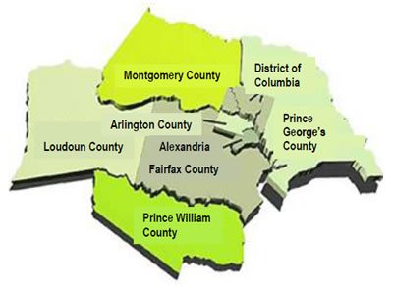
National Capital Regional Coordination
Regional incident coordination within the National Capital Region is executed though the activation of the Regional Emergency Coordination Plan (RECP).
Notes:
MEMA works with select counties from Virginia, Maryland, and the District of Columbia comprise the National Capitol Region and engage in joint planning and coordination efforts to benefit the region. National Capital Regional coordination is executed through the Regional Emergency Coordination Plan (RECP).

Slide 41
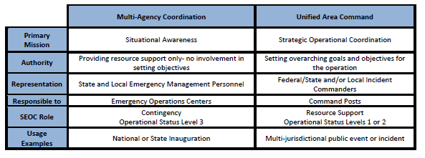
Alternate Response Architectures and Applications
Notes:
The MJOC/SEOC is the primary architecture under which the State conducts consequence management. There are two alternate architectures that are used under specific circumstances: the Multi-Agency Coordination Center (MACC) and the Unified Area Command (UAC).

Slide 42
SEOC Demobilization
As response scales down, the need for SEOC support to local jurisdictions lessens.
ESFs begin to be unnecessary as activities are supported with normal operating procedures.
SEOC demobilization and transition begins, if necessary, to recovery operations.
Notes:
Eventually, a return to State Response Activation Level 4 occurs, and MEMA returns to normal operating conditions and as response activities scale down and transition away from life safety and property protection, the need for SEOC support to local jurisdictions lessens.
ESFs begin to be unnecessary as activities are supported with normal operating procedures by State departments/agencies or autonomously by the impacted local jurisdiction.

Slide 43
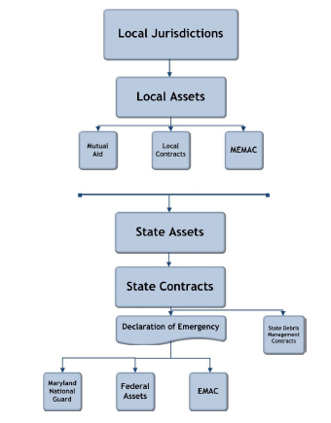
Declarations
State of Emergency
Presidential Declaration
  Emergency Declaration
  Major Disaster Declaration
Notes:
Declarations allow the State and local jurisdictions to take extraordinary measures, and to provide and receive emergency assistance during an event or incident that overwhelms the resources of the local jurisdiction or the State.
Initially, local jurisdictions rely on pre-existing mutual aid agreements with neighboring jurisdictions or the Maryland Emergency Management Assistance Compact (MEMAC).
Local jurisdictions can also seek resources assistance from the State, which, in turn, can secure mutual aid from neighboring states through a process known as the Emergency Management Assistance Compact (EMAC), or through the federal government. The figure here illustrates the various levels of mutual aid assistance available during disasters.

Slide 44
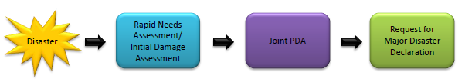
Damage Assessment Process
Damage Assessments are required to determine the extent of damage in order to request this type of Declaration.
There are three distinct steps that occur during the Damage Assessment process.
Notes:
While each disaster presents its own unique set of challenges to communities, there are certain steps that will need to be taken in order to secure federal assistance for individuals living in impacted communities after any disaster.
The process requires that specific information be collected by local jurisdictions (with some assistance from both the State and federal governments) and submitted to MEMA to support the State’s request to the President for an Individual Assistance Declaration.
Clear, timely, and accurate damage assessment data will make the Declaration Request Process significantly easier to manage for all parties involved, and will expedite getting the necessary resources to impacted communities. Additionally, the data collected to support this process will be used in the planning for other recovery efforts.
The figure illustrated here walks you through the Damage assessment process.

Slide 45
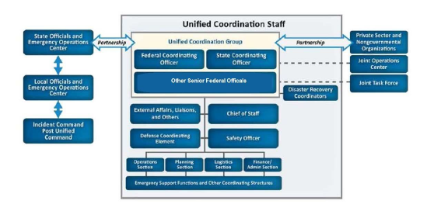
Federal Assistance
Regional Response Coordination Center (RRCC)
Joint Field Office (JFO)
Notes:
The federal government is always ready to support the state’s in need of assistance. FEMA Region III works with the emergency management agencies of Maryland, Pennsylvania, Delaware, Virginia, West Virginia, and Washington D.C. When the State Response Activation Level is elevated in response to an incident or in anticipation of a planned event the MJOC will notify FEMA Region III.

Slide 46
Mutual Assistance Compacts
Interstate Assistance
  Emergency Management Assistance Compact (EMAC)
Intrastate Mutual Assistance
  Maryland Emergency Management Assistance Compact (MEMAC)
Notes:
There are two types of mutual assistance compacts.
Interstate Assistance is out-of-State assistance through formal State-to-State agreements such as the Emergency Management Assistance Compact (EMAC), or other formal State-to-State agreements that support the response effort.
Intrastate Assistance are agreements, often coordinated through the State, that incorporate both State and local governmental and nongovernmental assets in an attempt to increase preparedness statewide.
There are pre-existing processes in place to address the legalities of the mutual assistance process.

Slide 47
Webinar
MEPP Overview
SROP
SEOC
Activation
ESFs

Slide 48
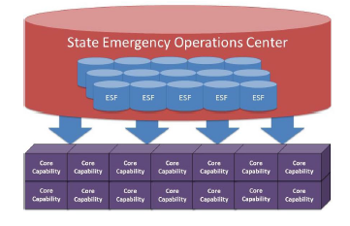
Maryland Emergency Support Functions (ESFs)
Maryland designated 17 ESFs to plan and carry out various operational activities.
ESFs form the basis of the SEOC Operations Section.
Note: not all local incidents requiring State-level support will result in the activation of ESFs.
Notes:
The State Emergency Support Functions, otherwise referred to as ESFs are the primary coordinating mechanism for building, sustaining, and delivering the capabilities of the Response Mission Area. ESFs bring together the capabilities of State departments and agencies and other statewide organizations and assets.
They are not based on the capabilities of a single department and/or agency, but represent groups of organizations that work together to deliver capabilities and support effective response operations.
When the State Response Activation Level has increased to a level 2 or 1, individual State departments and or/agencies operate as a state-level enterprise, coordinating activities within their respective ESFs and amongst the Branches of the Operations Section. ESFs support not only a number of response capabilities, but also a number of responsibilities and actions that extend beyond the scope of the capabilities of the Response Mission Area.

Slide 49
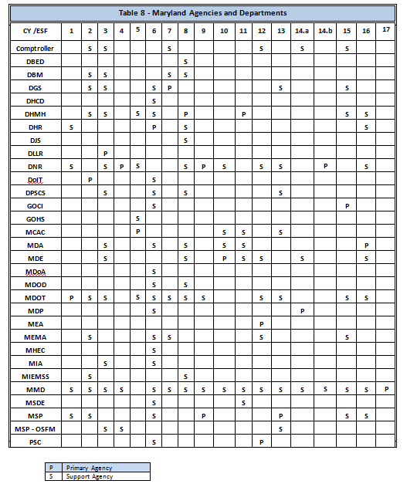
ESFs Cont.
The ESF Primary has ongoing preparedness responsibilities, as well as management responsibilities, within the SEOC.
Support organizations are those entities with specific capabilities or resources that support the Primary Agency in executing the mission of the ESF.
Notes:
Each ESF identifies its Primary Agency and support organizations. A support organization may be a State department/agency, a federal department/agency, a non-governmental organization, or a private-sector organization. The table here lists all Maryland State Agencies and Departments that are either the primary lead or play a support role to the ESFs.

Slide 50
Planning Process and Plan Maintenance
SROP is updated bi-annually by the ESFLG using the National Plan Development Process.
Capability Annexes and ESF Annexes will be updated annually through implementation of the Maryland Preparedness System.
After Action Reports (AAR) and Improvement Plans (IPs) from exercises/incidents may identify the need for an incremental update of the plans.
Notes:
The State Response Operations Plan is updated on a bi-annual basis in accordance with the Maryland Emergency Preparedness Program Strategic Plan.

Slide 51
Resources
MEPP Strategic Plan - http://mema.maryland.gov/community/Documents/2013_MEPP_StratPlan_SIGNED.pdf
SROP - http://mema.maryland.gov/Documents/SROP_V3_03_MAR-15.pdf

Slide 52
Closing Remarks
Brendan McCluskey, Director of Preparedness

Slide 53
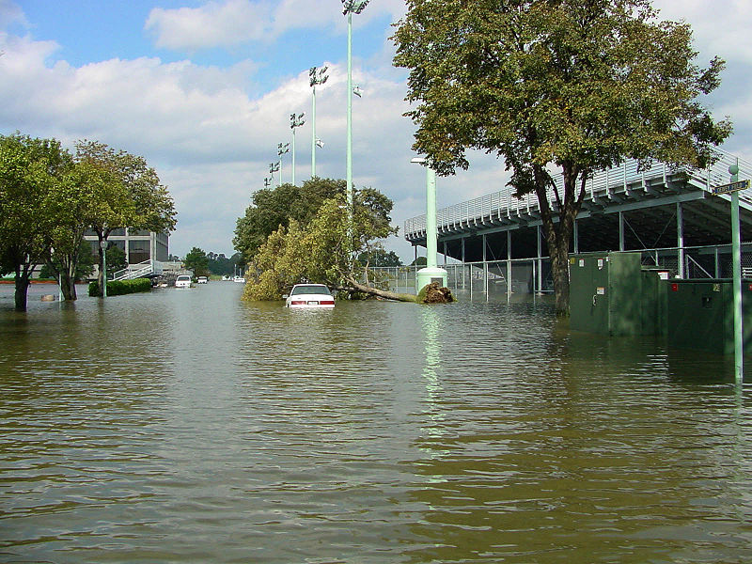
Thank You! Questions?
http://mema.maryland.gov
Nicole Lanigan M.S.
Senior National Capital Region Planner
Adaptive Planning
Preparedness Directorate
Maryland Emergency Management Agency
5401 Rue Saint Lo Drive
Reisterstown, MD 21136
443-826-0158 (c)
Nicole.Lanigan@Maryland.Gov

